Slide 1








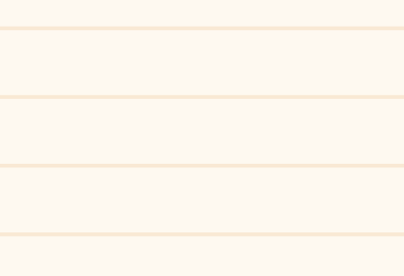
GLOO
LO-FI PROTOTYPING
CS147: Assignment 5

Slide 2


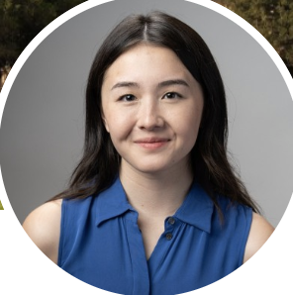
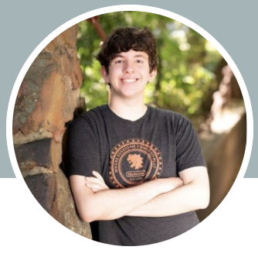
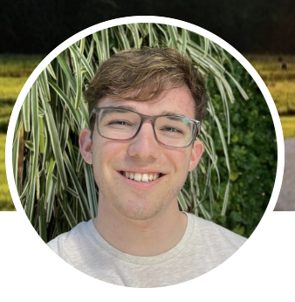
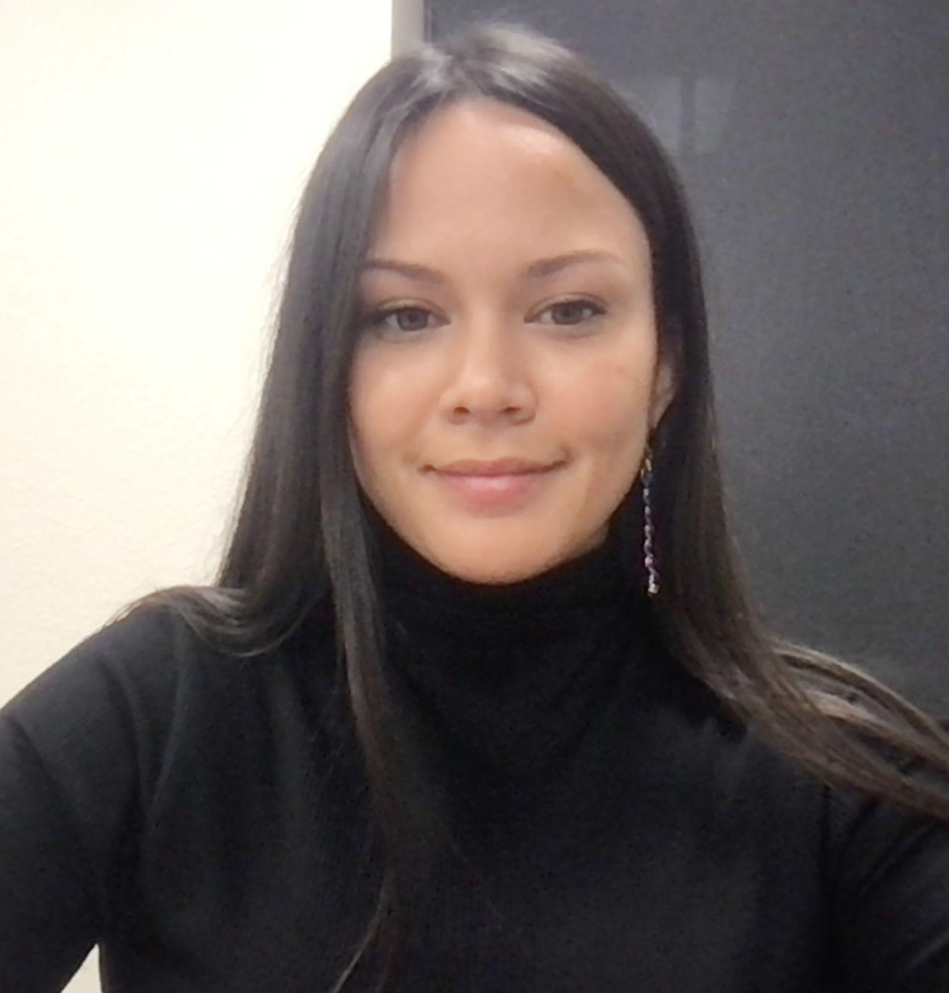
The GLOO CREW
Meet the Team!
Alison Rogers
Matthew Mattei
Justin Blumencranz
Monica Hicks
Coterm
Computer Science
Junior
Computer Science
Senior
Symbolic Systems
Coterm
Computer Science

Slide 3
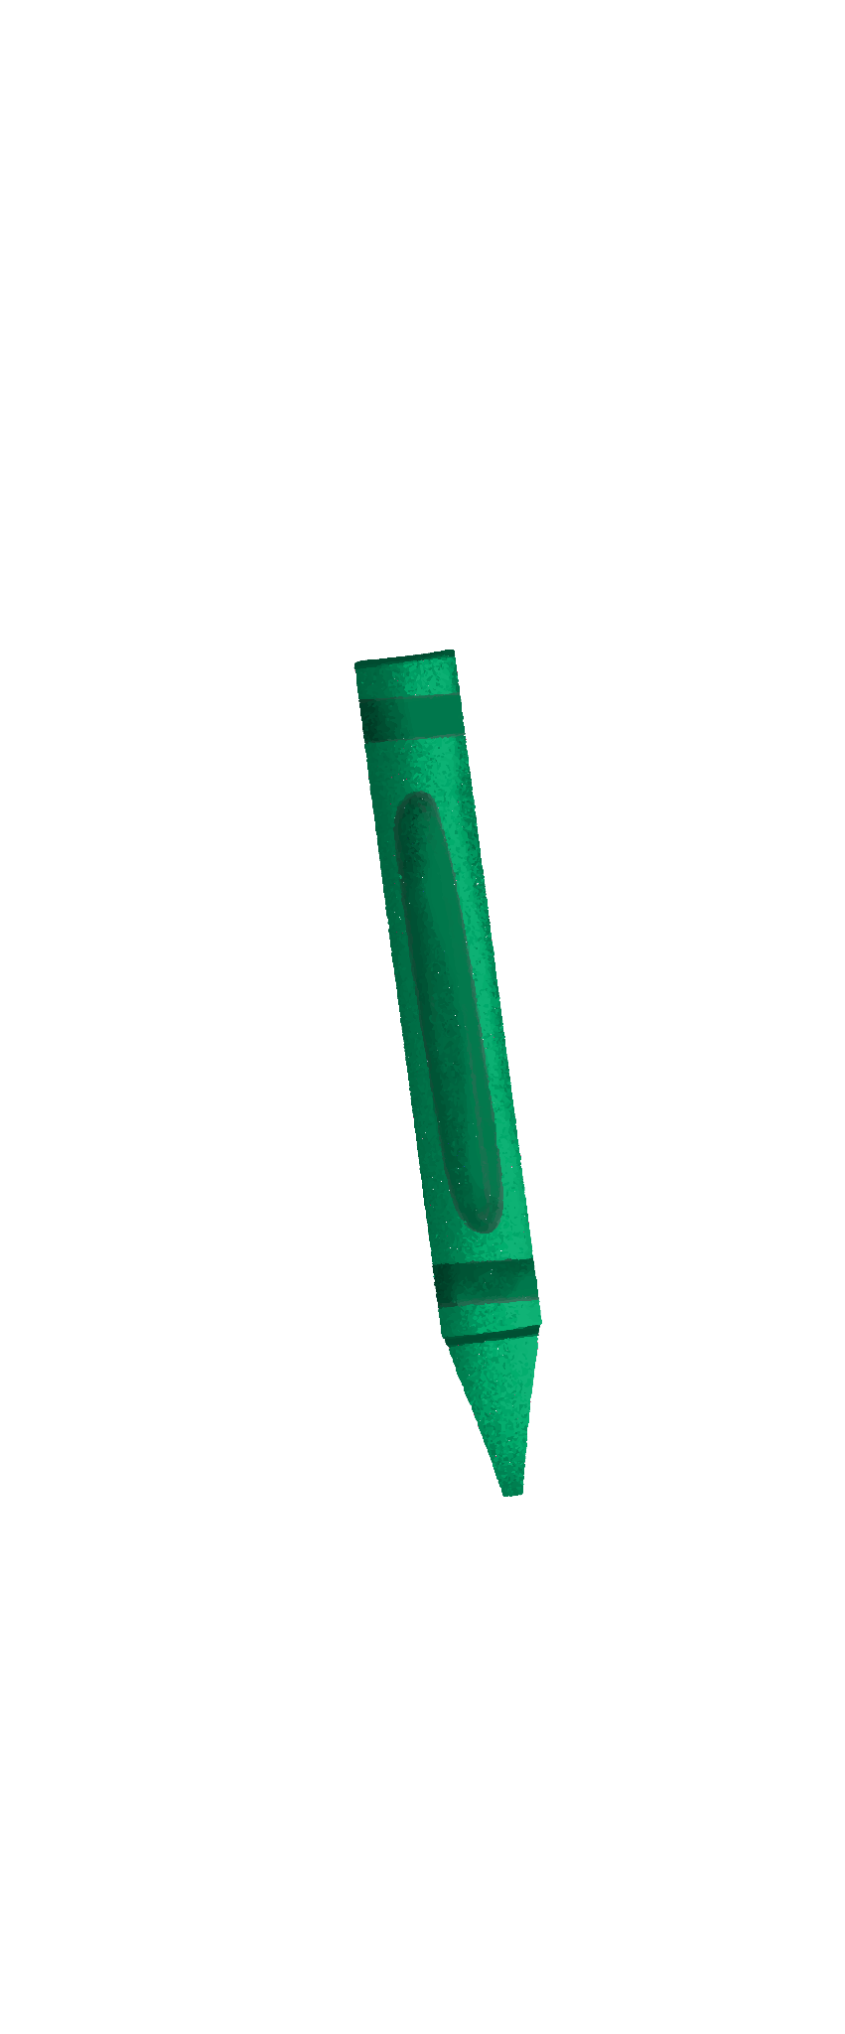
VALUE PROPOSITION
“Making student-teacher connections that stick!”

Slide 4
PROBLEM
Especially in larger schools, students feel daunted by, and disconnected from, the college application process while teachers have a hard time connecting with students and being able to advocate for them.

Slide 5
SOLUTION
A platform for high school students and teachers who feel disconnected due to the large size of their school to easily schedule times to meet and connect with each other.
Gloo includes a journaling interface to help both students and teachers remember and reflect on their interactions for future reference and an AI algorithm based on interests and student journals to help create personalized teacher recommendations for students.

Slide 6

TABLE OF CONTENTS
01
02
03
SKETCHING
INTERFACE
PROTOTYPE
04
05
06
TESTING
DISCUSSION
APPENDIX

Slide 7



01
SKETCHING

Slide 8
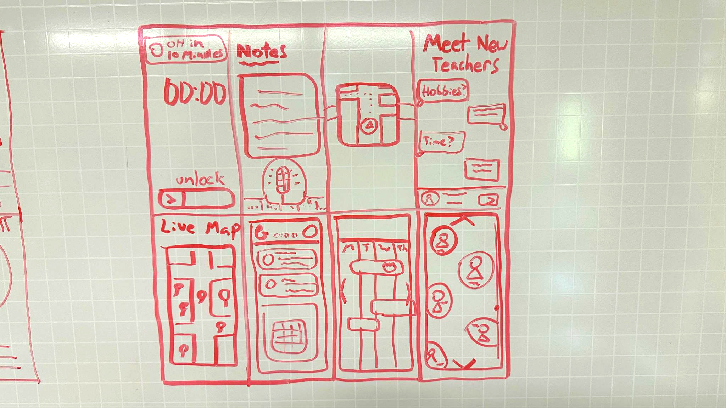
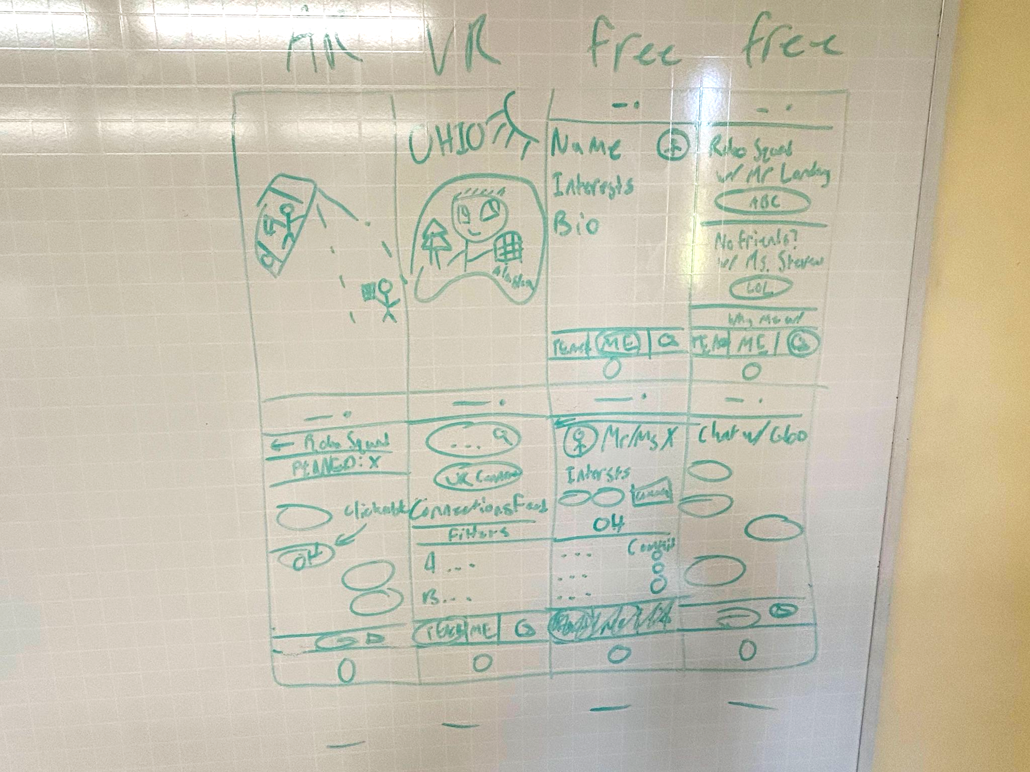
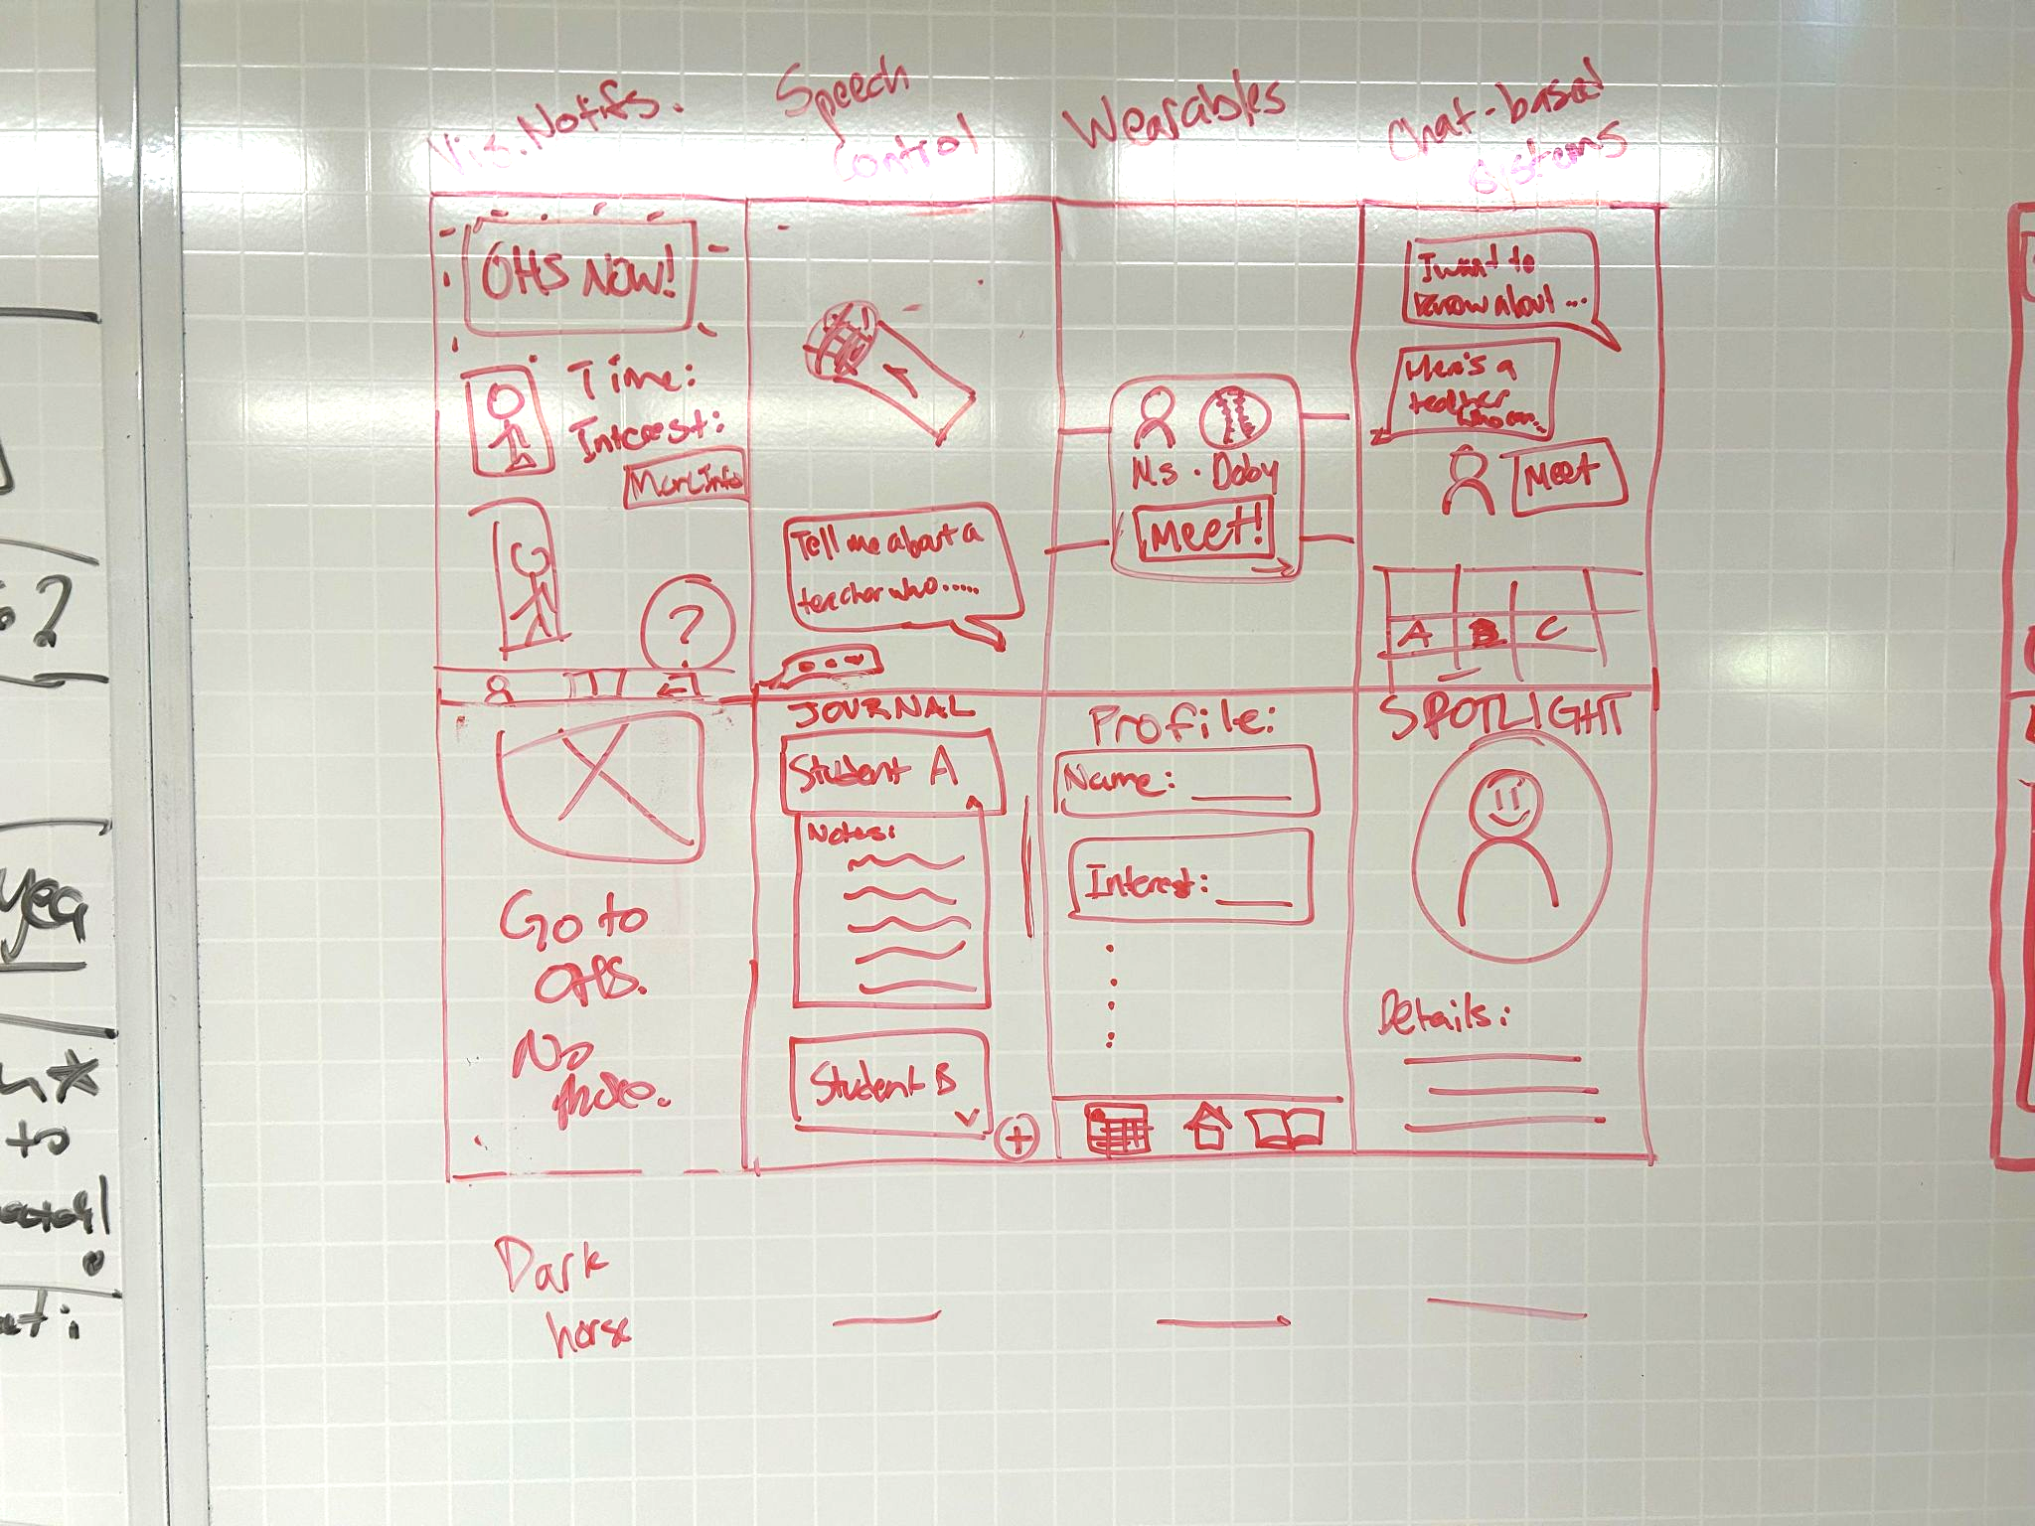
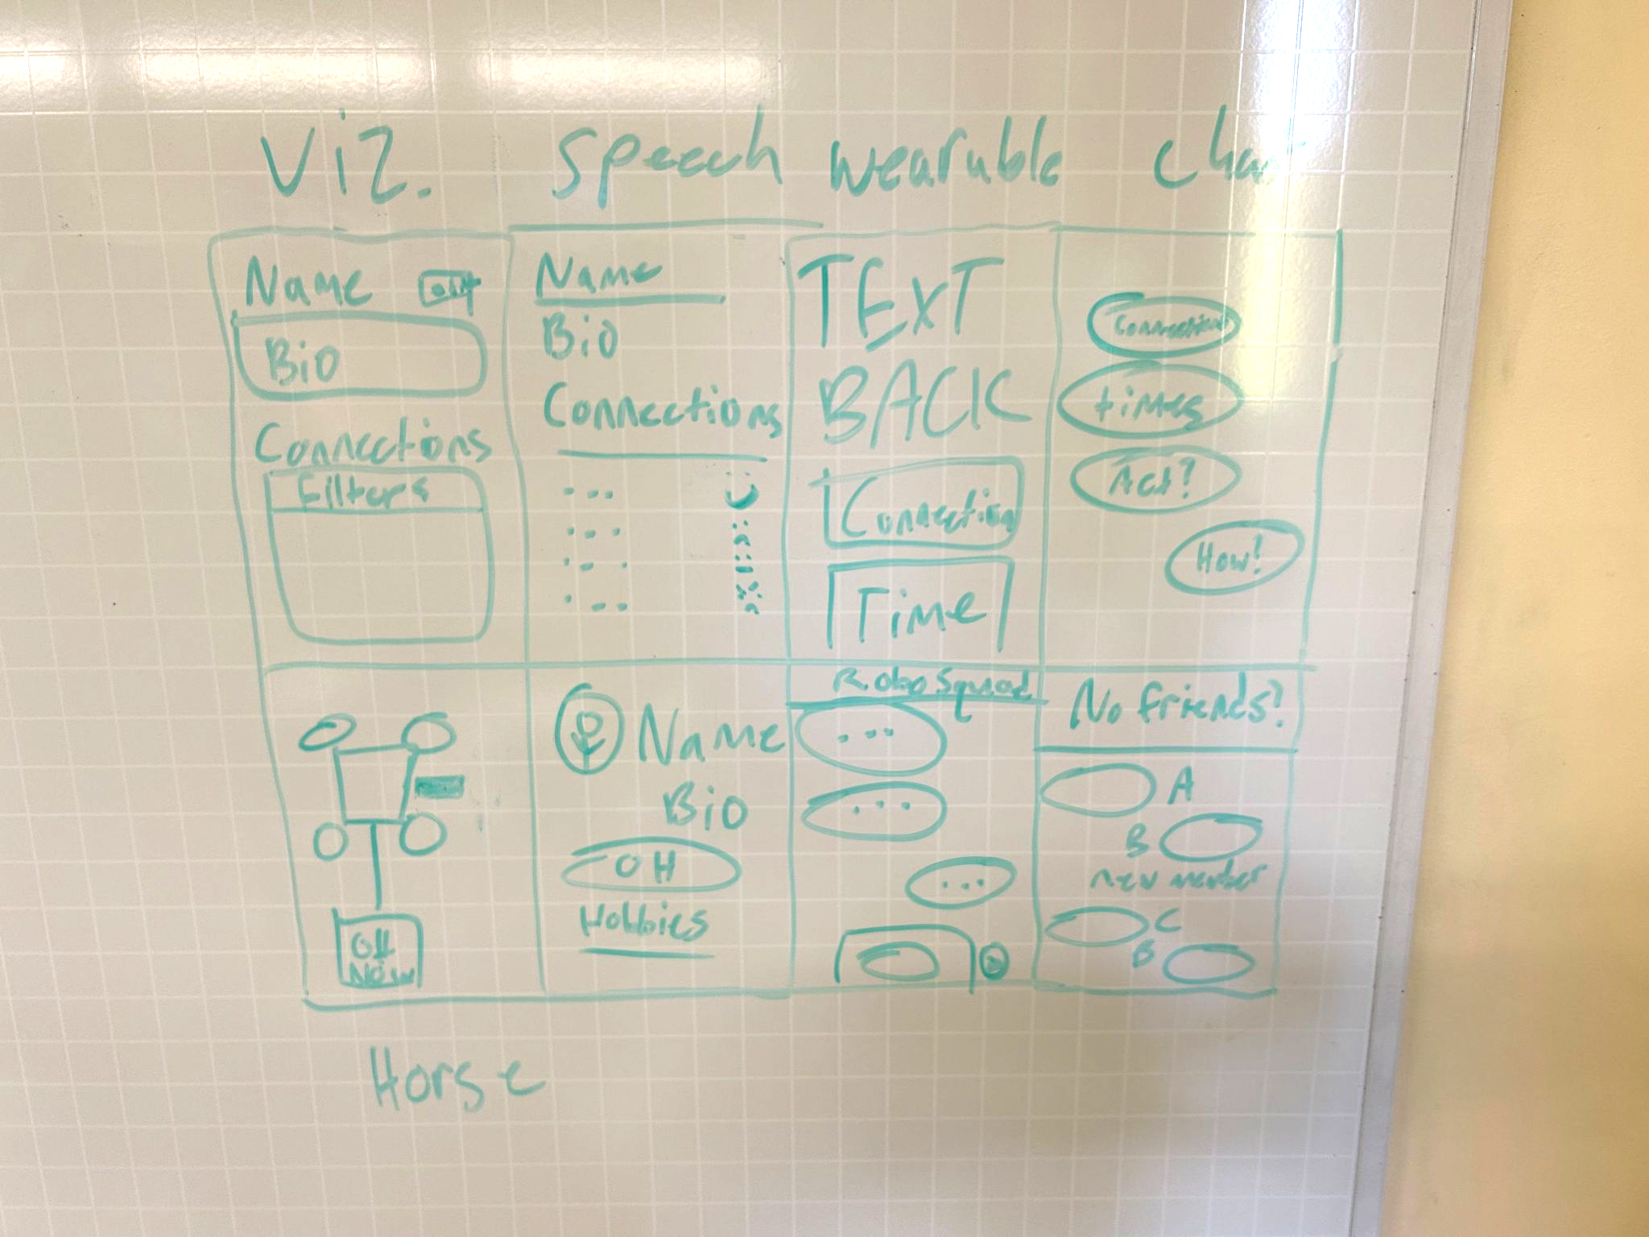
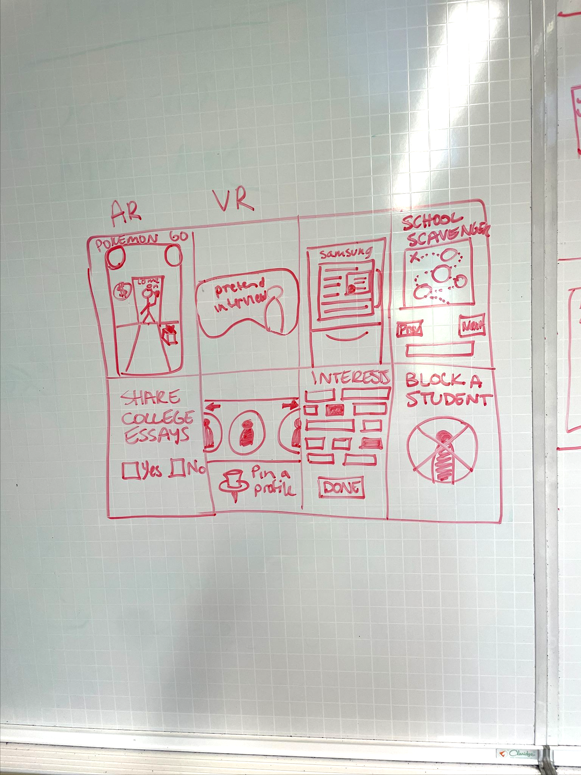
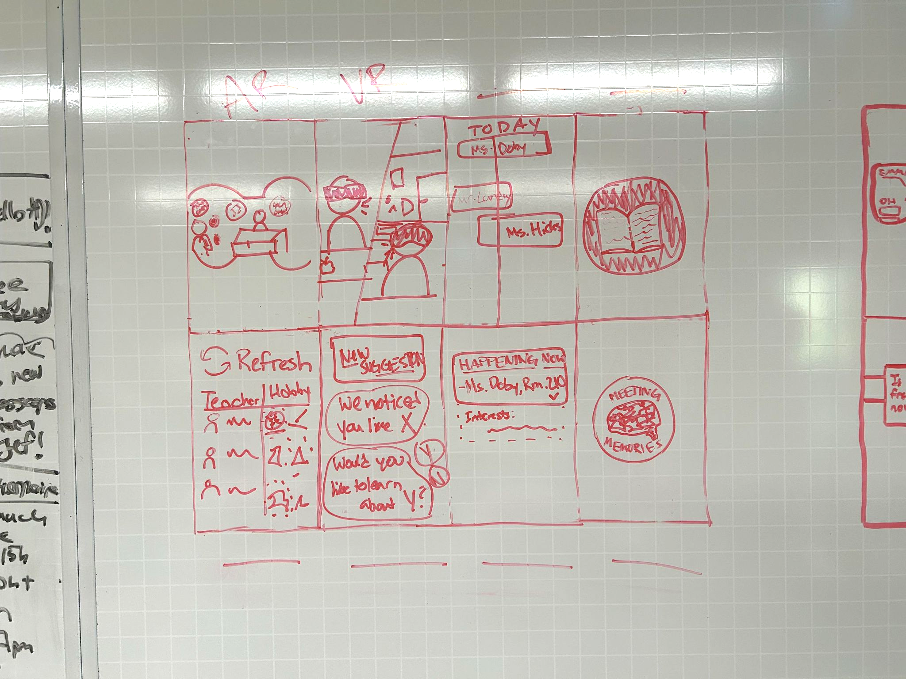
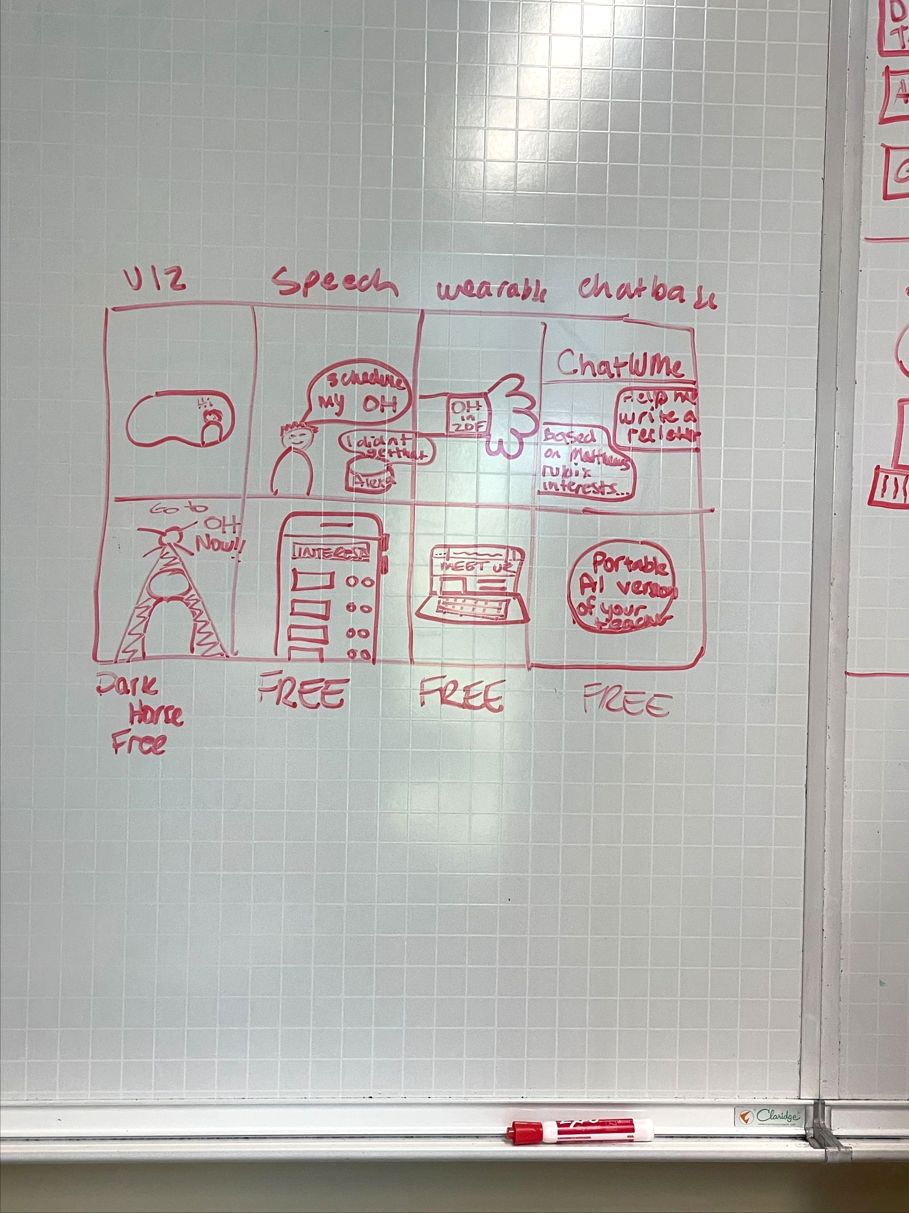
CONCEPT
SKETCHES:
PHONE

Slide 9
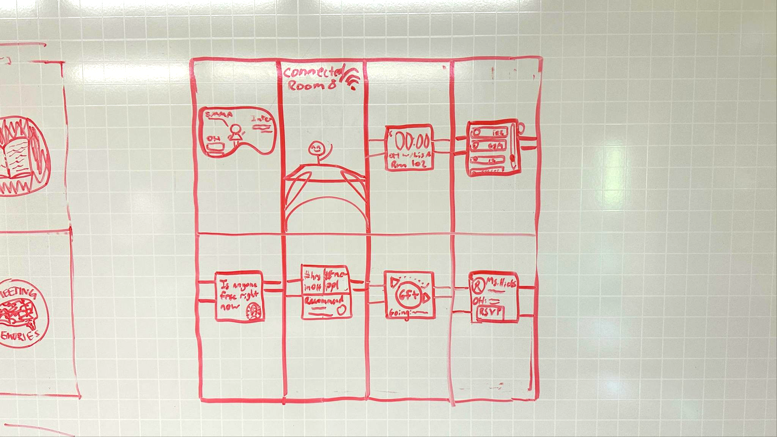
CONCEPT
SKETCHES:
WATCH

Slide 10
CONCEPT
SKETCHES:
OTHER
VR
AR

Slide 11
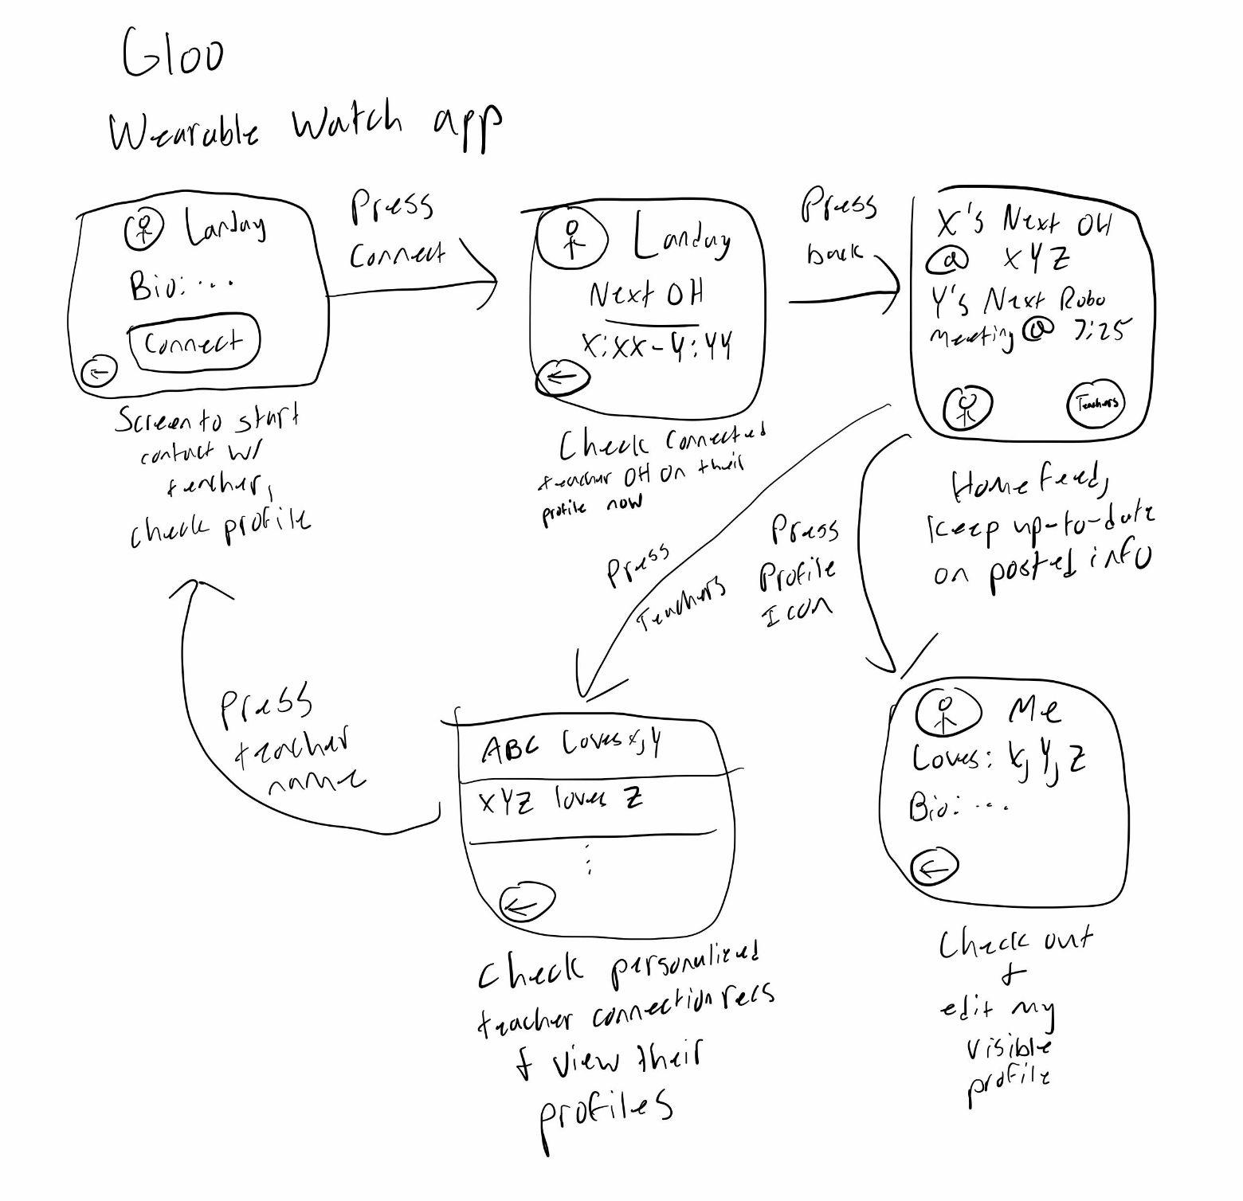
FLESHED OUT: WATCH
Pros:
Cons:
-Convenient notifications
-More acceptable than phones in classrooms
-Inaccessible
-Small screen

Slide 12
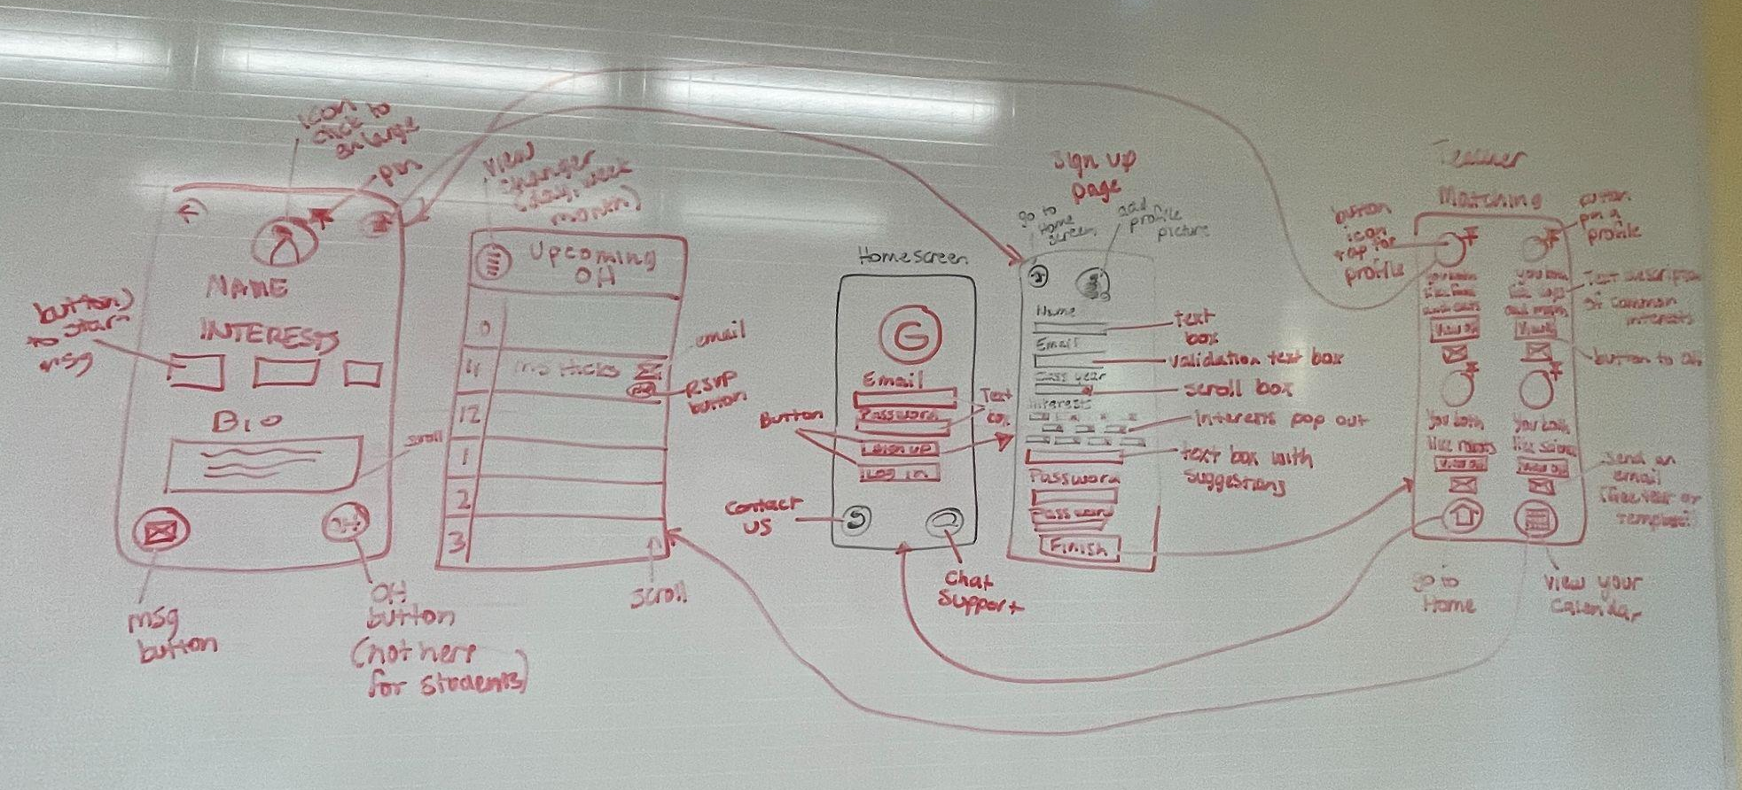
FLESHED OUT: PHONE
Pros:
Cons:
-Easily display lots of data
-Stronger for calendar + messaging
-Risks encouraging phone use in school
-Long-form notes can be inconvenient

Slide 13
02
INTERFACE

Slide 14
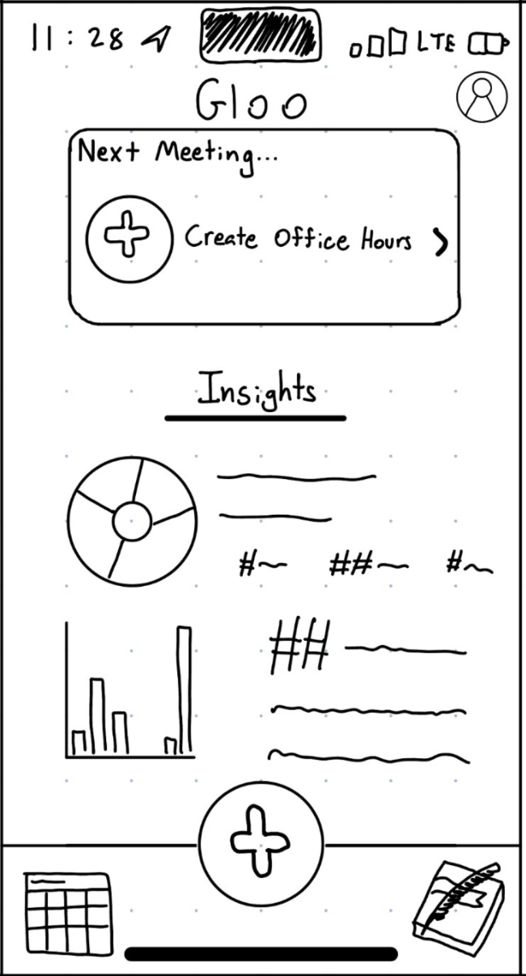
PHONES!

Slide 15
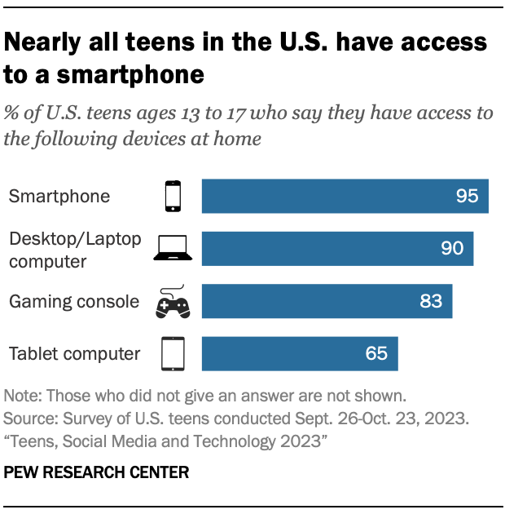
DATA & FINDINGS
95% of teenagers have access to a smartphone…
…compared to smartwatches at only 13%.
Watches are also becoming discouraged or even banned in classrooms.
Phones, while also often discouraged, are easier to use in short periods between classes. They don’t require set up.

Slide 16
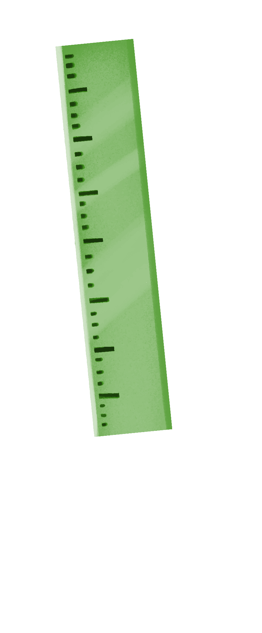

OUR RATIONALE
Phones are more widely used, something students can easily use intermittently while in school, and can support the more complex interfacing that we need for Gloo, like typing and scheduling.

Slide 17
03
PROTOTYPE

Slide 18
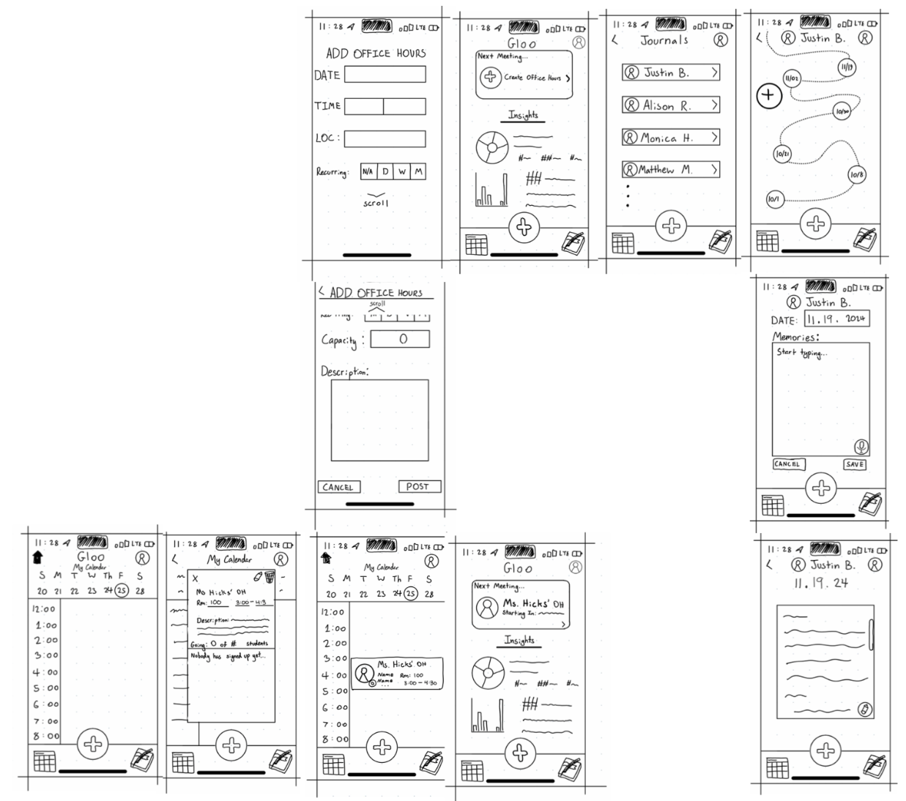
CREATION!
SKETCHED
STUDENTS VIEW
PRINTED
DIGITIZED
By hand using Notability
On printer paper, operated by a person swapping pages. Interactions available: buttons and scrolling.
For our Zoom interviews, we used Marvel

Slide 19
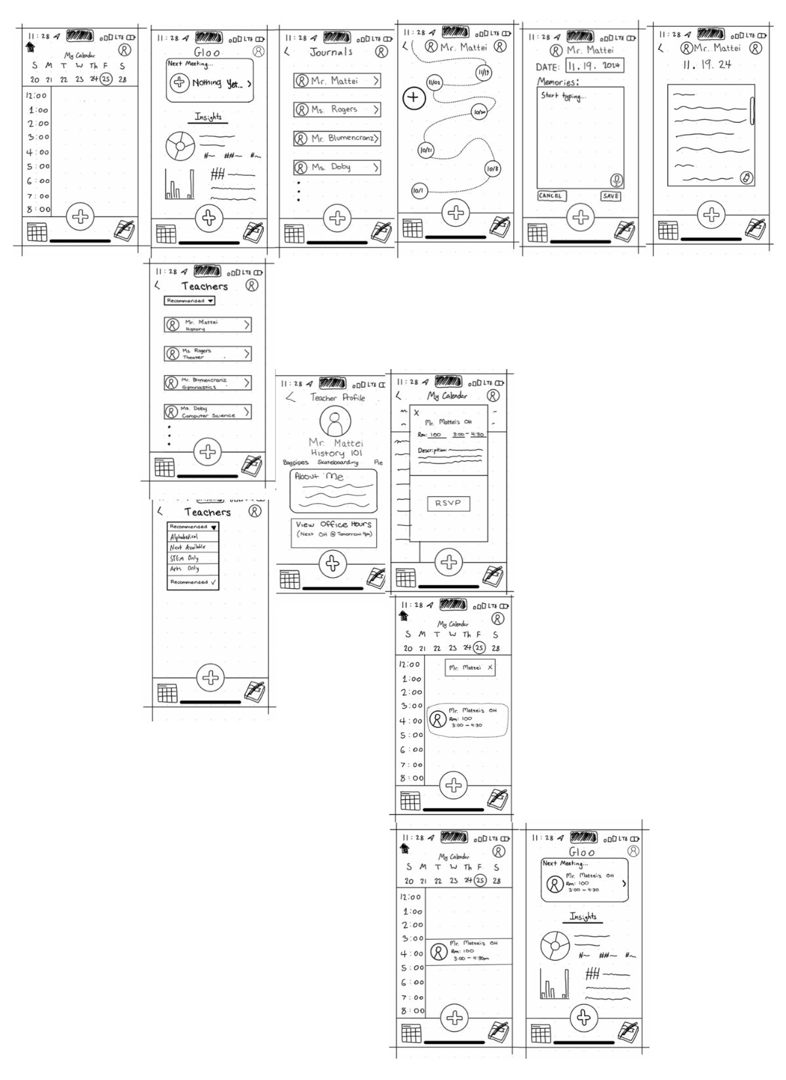
CREATION!
SKETCHED
PRINTED
DIGITIZED
TEACHER VIEW
By hand using Notability
On printer paper, operated by a person swapping pages. Interactions available: buttons and scrolling.
For our Zoom interviews, we used Marvel

Slide 20
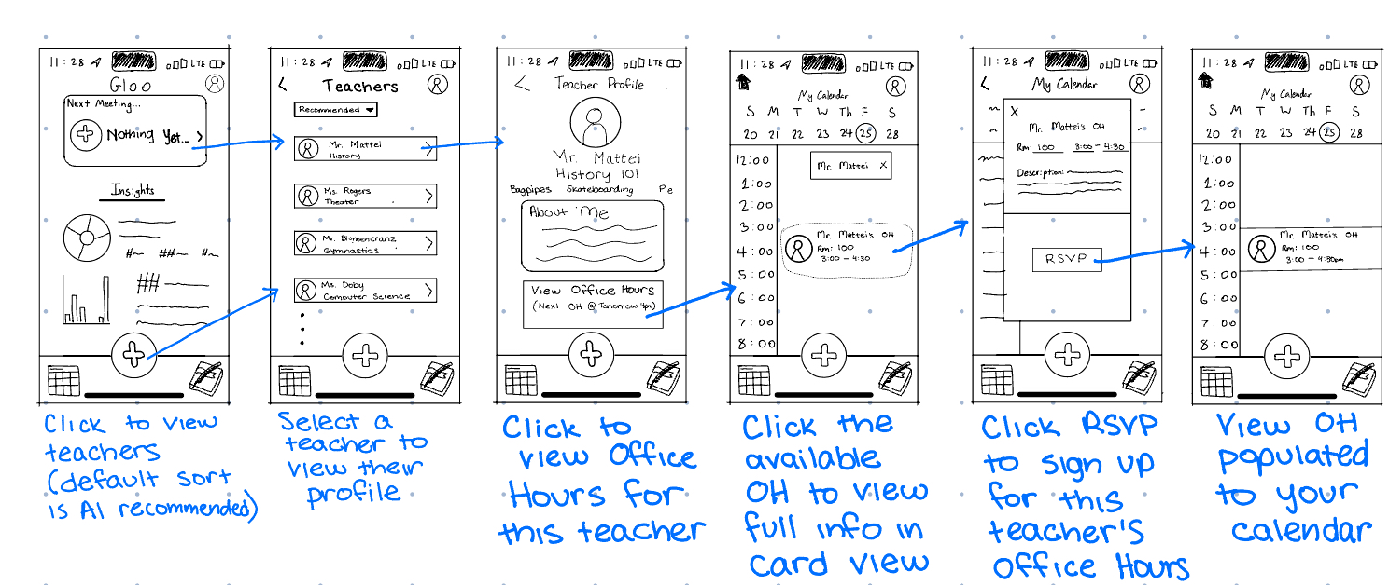
SIMPLE TASK FLOW:
FIND A CONNECTION
FOR STUDENTS

Slide 21
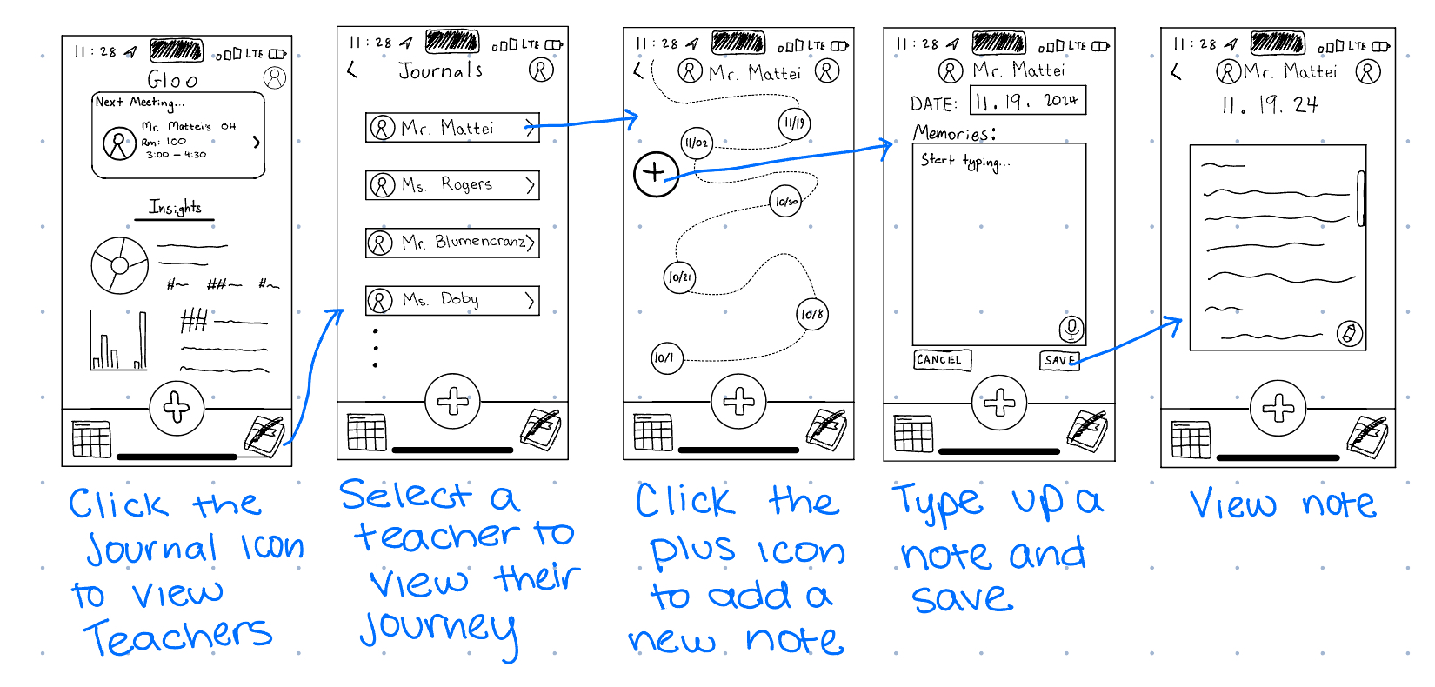
MODERATE TASK FLOW:
JOURNAL AN INTERACTION
FOR STUDENTS

Slide 22
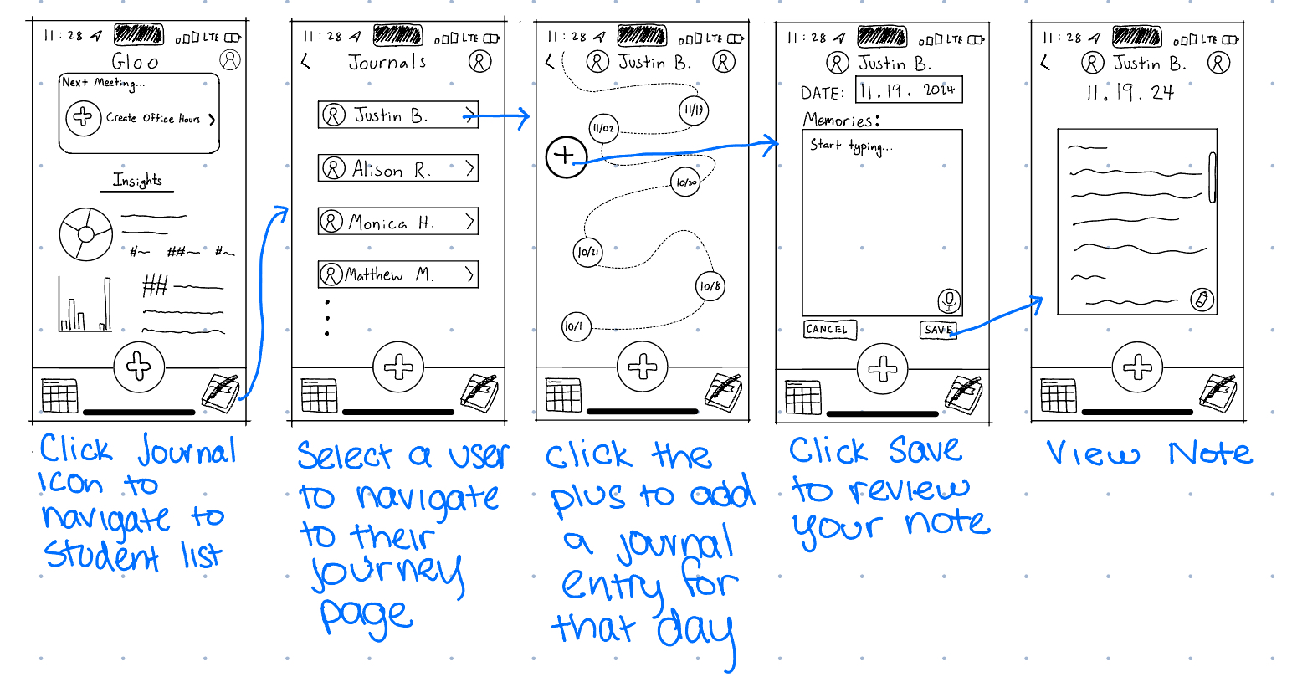
MODERATE TASK FLOW:
JOURNAL AN INTERACTION
FOR TEACHERS*
*Very similar to the student version! Just slightly different content

Slide 23
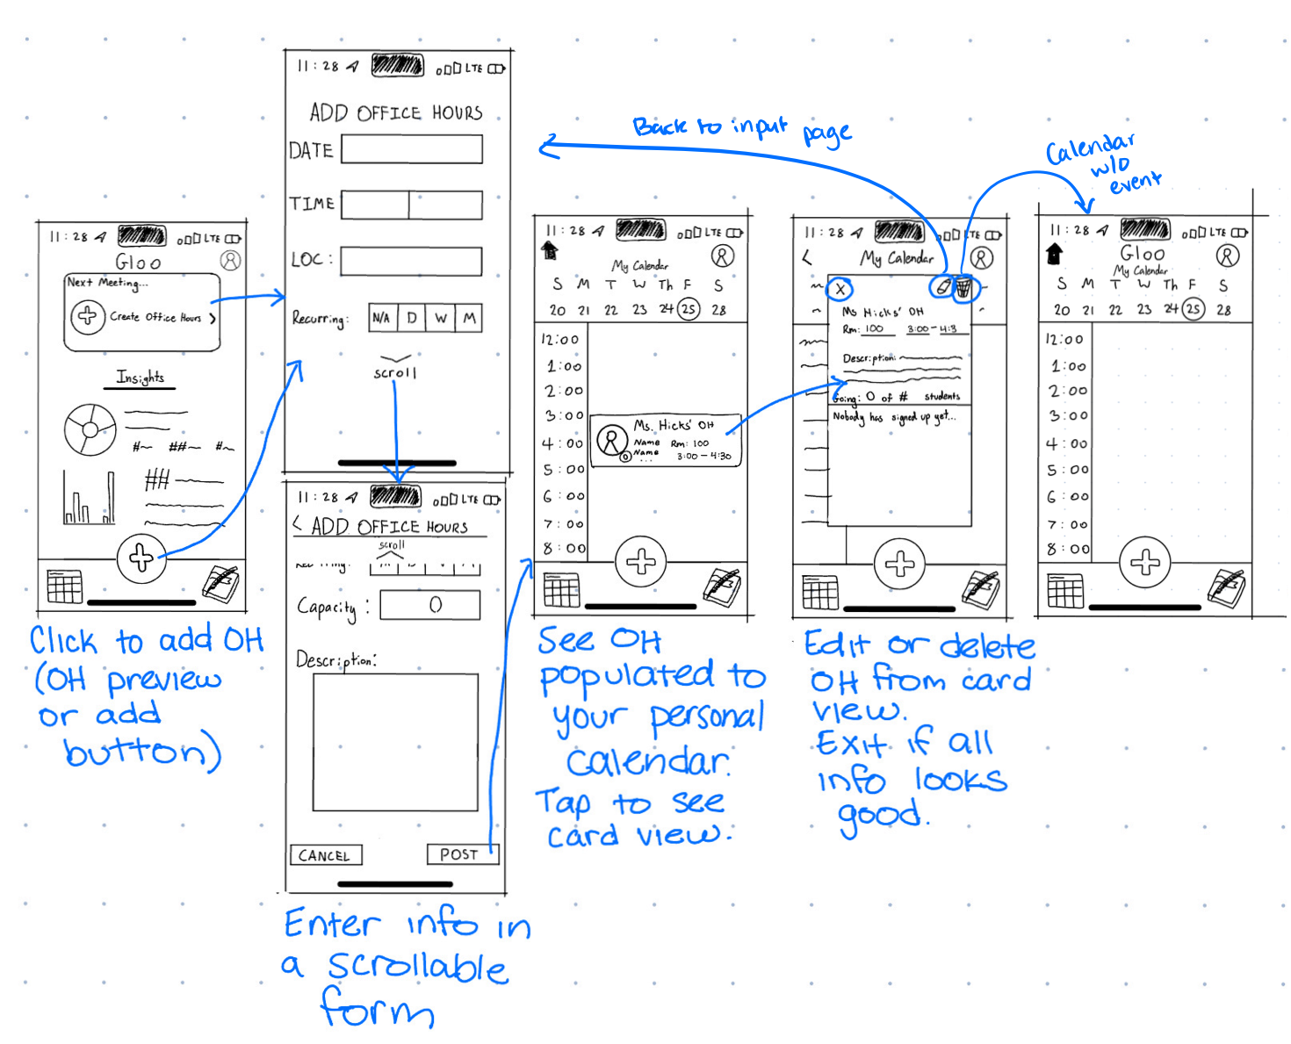
FOR TEACHERS
COMPLEX TASK FLOW:
CREATE AND SHARE OFFICE HOURS

Slide 24
04
TESTING

Slide 25
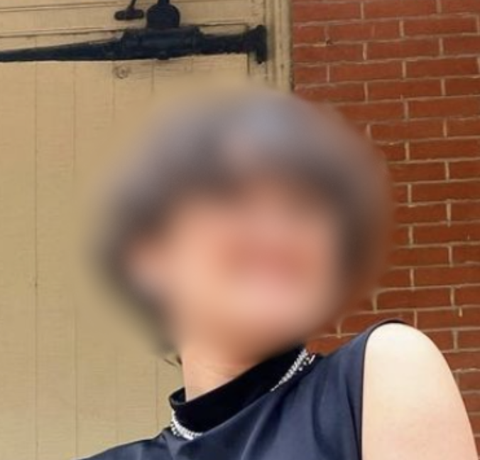
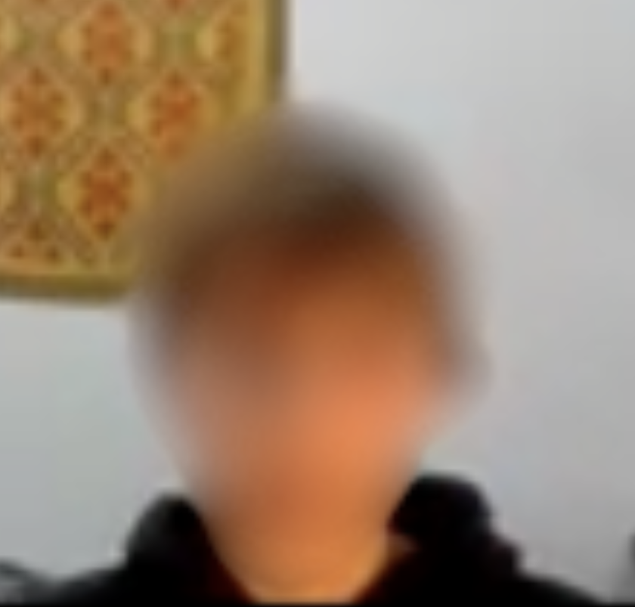


PARTICIPANTS: STUDENTS
ALAN
LUKE
SAWYER
NATASHA
Recruited via snowball recruitment and cold-approaches. Compensated with appreciation. Blue circles conducted via Zoom.
A Philly high school student
An NYC high school student
A Bay Area high school student
A Spokane high school student

Slide 26
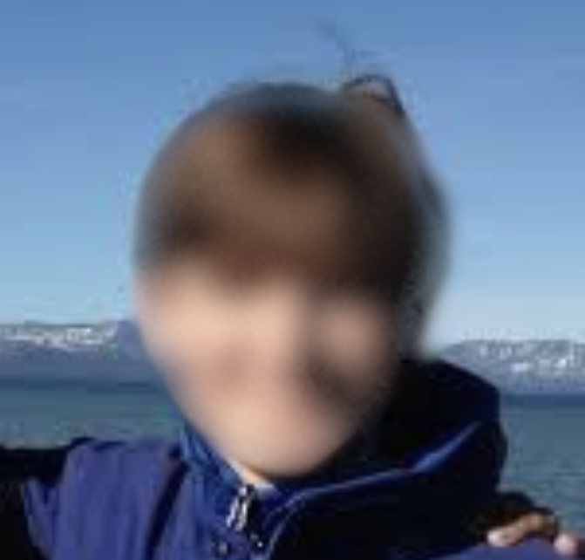

PARTICIPANTS: TEACHERS
NICO
CALLIE
Recruited via snowball recruitment and cold-approaches. Compensated with appreciation. Blue circles conducted via Zoom.
A Bay Area professor
A Seattle teacher

Slide 27
ROLES
FACILITATOR
NOTETAKER
COMPUTER
FACILITATOR/
NOTETAKER

Slide 28

PROCEDURE
INTRODUCE GLOO
TASK EXECUTION
DEBRIEF
Provide a brief description of how the setup works
Ask the participant to execute their tasks. A few tasks had small follow-ups (e.g. “how would you edit your office hours?”
Ask about any observed confusion during the tasks. Gather thoughts and opinions from the user.

Slide 29
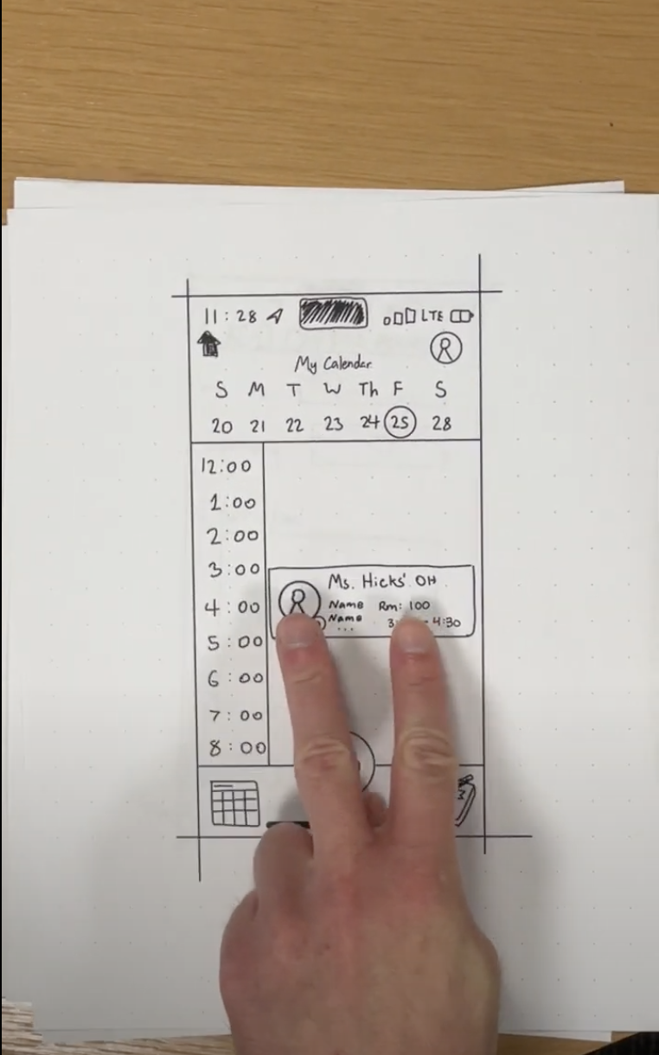
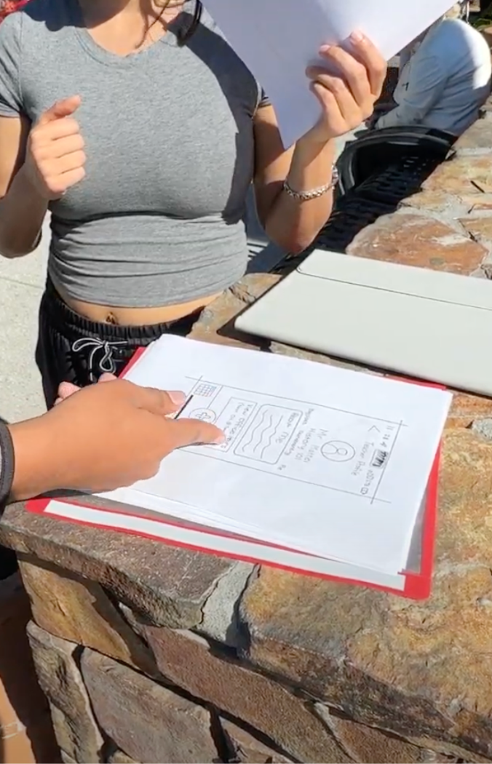
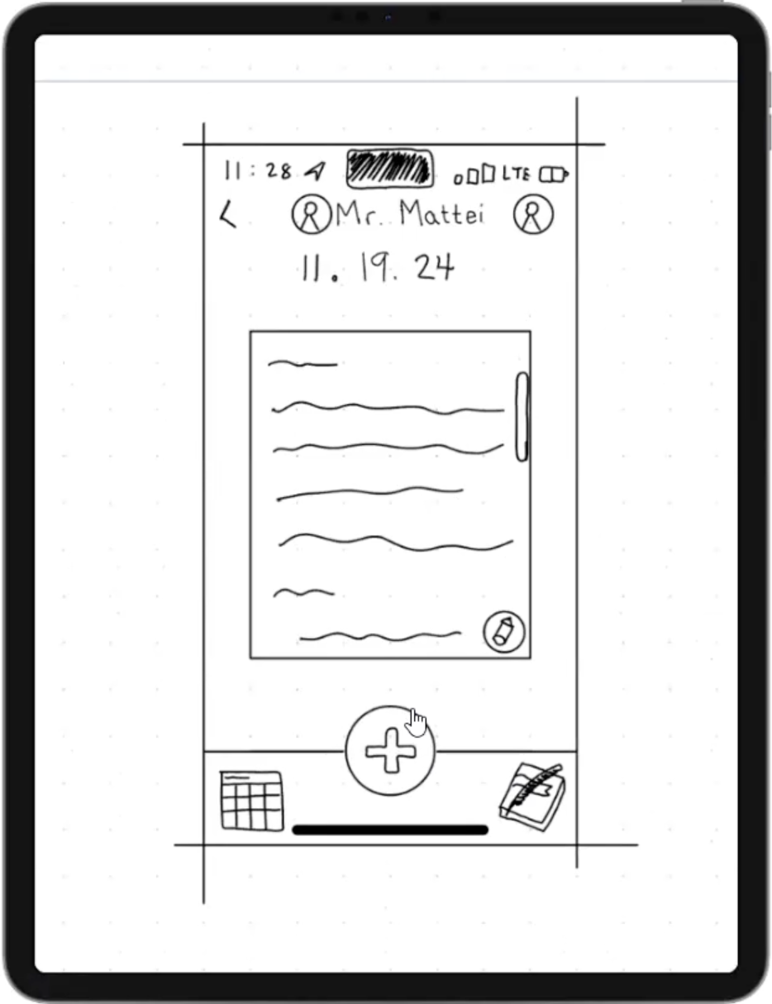
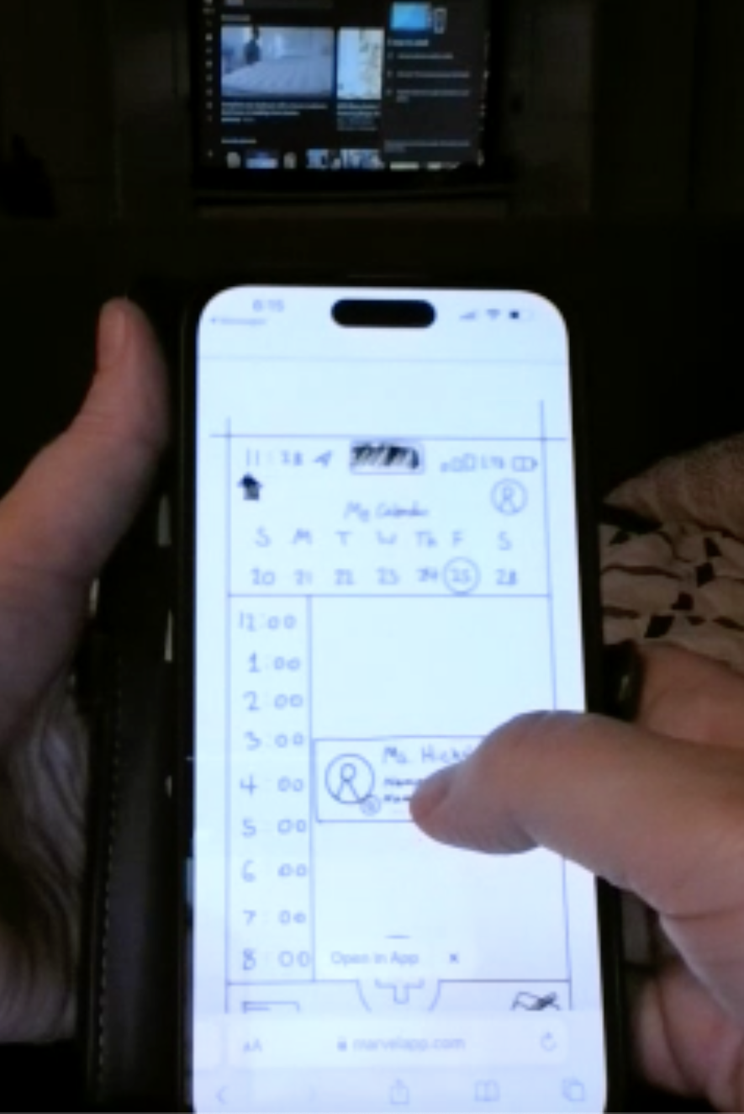
ENVIRONMENTS
PHYSICAL
VIRTUAL
}
}

Slide 30
WHAT WERE WE LOOKING FOR?
GOAL | METRIC
Navigable | Clicks in the wrong direction
Simple | Time to complete task
Approachable | Decision time

Slide 31
WHAT WERE WE LOOKING FOR?
GOAL | METRIC
Navigable | Clicks in the wrong direction
Simple | Time to complete task
Approachable | Decision time

Slide 32
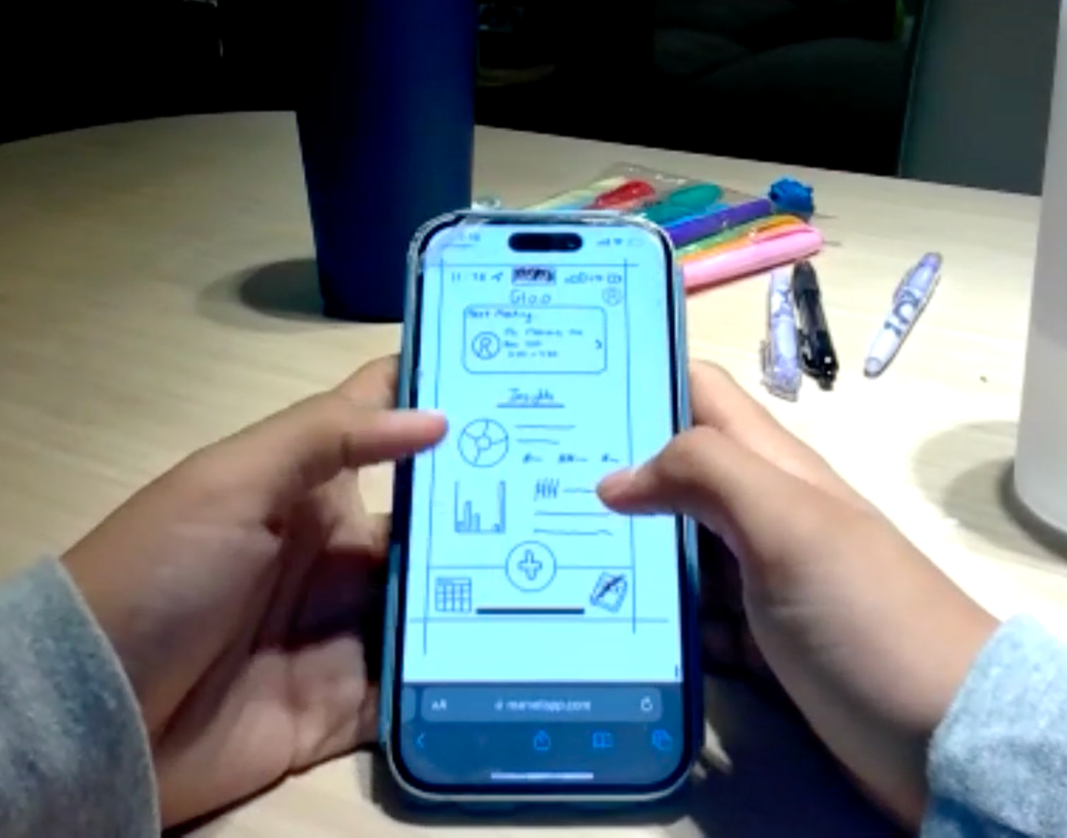
SO…
WHAT DID WE FIND?

Slide 33
THE BIG PICTURE
DIFFICULT TO START
EASY TO PICK UP
Confusion about the layout was common, especially as users were first orienting themselves.
Multiple participants commented on the helpful iconography, and everyone was able to complete their tasks!

Slide 34
BOTTOM-LINE DATA
55
67.1 seconds
5.03 seconds
Clicks in the wrong direction
Average time to complete each task
Average decision time

Slide 35

LOOKING DEEPER
66%
91%
POPULATION
MISCLICKS
Students were 66% of our sample size…
…but 91% of our misclicks!

Slide 36
1.8x longer
The average additional time it took teachers to complete tasks compared to students

Slide 37
1.8x longer
CONTEXT: TEACHERS HAVE MORE INVOLVED TASKS
The average additional time it took teachers to complete tasks compared to students

Slide 38
-CALLIE, COMPLIMENTING GLOO
“I’ve been teaching for 20 years. I didn’t start my career with…scheduling on computers. I’m not a tech native at all, so things being intuitive is super important to me and my career.

Slide 39
“The journal icon is very clear!”
“The calendar is missing some features.”
“I LOVE voice to text!”
“It doesn’t feel right.”

Slide 40
LET’S REVISIT
GOAL | METRIC | ACHIEVED?
Navigable | 55 misclicks (5 teacher) | For teachers, but not students
Simple | >1 minute/task average | Not quite, we want non-typing tasks to be well under 60s
Approachable | 5.03 s/decision average | This is really promising!

Slide 41
LET’S REVISIT
GOAL | METRIC | ACHIEVED?
Navigable | 55 misclicks (5 teacher) | For teachers, but not students
Simple | >1 minute/task average | Not quite, we want non-typing tasks to be well under 60s
Approachable | 5.03 s/decision average | This is really promising!

Slide 42
05
DISCUSSION

Slide 43

IMPLICATION #1: MORE CLARITY
Nobody liked the multiple plus buttons. Even when there was only one, students didn’t know what the button meant
Similarity in pages was confusing for students
Teachers were confused by the redundancy in how to add notes

Slide 44
IMPLICATION #2: EASIER FOR TEACHERS
Teachers took longer, but made far fewer misclicks
The time discrepancy makes sense, because teachers have slightly more involved tasks.
Given that our students have simpler tasks, though, we need to make student task flow more intuitive to prevent confusion

Slide 45
IMPLICATION #3: RIGHT “SCHOOL” FEEL?
Some words felt “corporate”, (e.g. “capacity”)
Font isn’t everything for a paper prototype, but it did throw off one of our users, who said the font felt too “informal” for school
On the other hand, some elements were too school focused - the list of journals sorted by teacher reminded one user of assignments

Slide 46

OUR NEXT STEPS: CHANGES
CHANGE AND ADD WORDS TO BUTTONS
EXPAND CALENDAR CAPABILITIES
MAKE STUDENTS’ JOURNALS GENERAL
SET A BALANCED TONE
Clarify their meanings (especially the + buttons)
Allow for flexibility between users
Meet the expectations of the users
Reduce conflation of pages

Slide 47

WHAT DID WE MISS?
We can always explore more! Some things we didn’t test include:
Reactions to the actual act of journaling
Setting up a profile
How task flows feel for experienced users
These are things we hope to look into out more deeply in future iterations!

Slide 48
Q&A
We would love to hear your questions, thoughts, and comments!

Slide 49
06
APPENDIX

Slide 50
WATCH: PROS AND CONS
Pros
Cons
-More acceptable than phones in class
-More convenient to check notifications - especially useful for things like calendar reminders
-Integrates more naturally into daily life
-Most high school students do not have watches
-Smaller screen is much harder to navigate
-Inputting data on a watch is difficult
-Watch is designed for simple tasks (not moderate or complex)

Slide 51
PHONE (selected interface):
PROS AND CONS
Pros
Cons
-Ability to display a large quantity of data at once
-Commonly used by teachers/high schoolers, which leads to easier adoption
-Able to handle a wide variety of task difficulties
-Strong existing calendar + messaging system
-Can’t always have phones in the classroom/on school grounds
-Might encourage use of phones in school
-Inconvenient for long-form notes/journaling

Slide 52

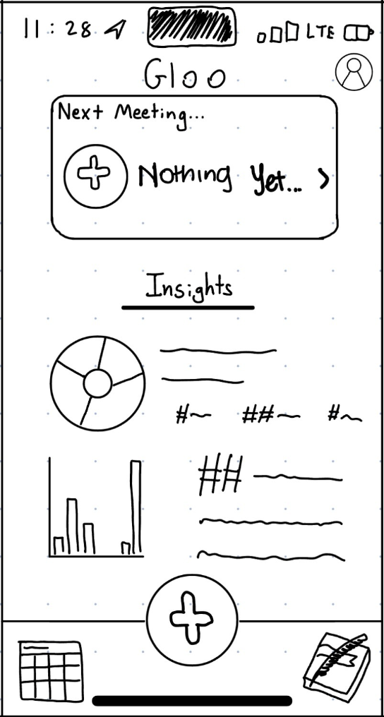
DIGITAL PROTOTYPES
TEACHER
STUDENT
https://marvelapp.com/ff73113
https://marvelapp.com/1109gg54

Slide 53
SCRIPT: INTRODUCTION
“Thank you so much for taking the time to test our app prototype! Our app is called Gloo; it is a platform for high school students to help them find and meet teachers in their school who share common interests and want to get to know students better.
We will have you interact with a paper prototype of the app. I will be the facilitator explaining what is going on, and my partner is going act as the app, moving the pages in response to your actions.
Here is the paper prototype. It is meant to mimic a smartphone screen. I will show you one screen at a time, starting on the home page. You can interact with the app by pressing on the paper with your finger. All of the functionality necessary to complete the task(s) we ask of you will work, but some of the extra buttons are not functional for this prototype.
While interacting with the prototype, we ask that you speak aloud as much as possible. Describe what you are thinking and doing in as much detail as you can. You should verbalize what you are doing every time you do something.

Slide 54
SCRIPT: TEACHER TASKS
Teacher:
Ask them to set recurring weekly office hours for Friday from 3-4:30pm in room 100.
“Create office hours, starting this Friday, from 3-4:30pm in room 100. Make it a weekly recurring meeting”.
Confirm the office hours are correct.
Ask “if I wanted you to change the date, how would you do it?”
Ask “if you wanted to delete these office hours, how would you do it?”
Ask them to create a journal entry for Justin.
“Today is November 19th, and you just had office hours with Justin. Add an entry for the current student”
Pay attention to:
Any misclicks.
Any time they are quiet: prompt them to narrate their process.
Times that tasks start and stop.
How they make the journal entry.

Slide 55
SCRIPT: STUDENT TASKS
Student:
Ask them to find teacher office hours and add them to their calendar
“Find a teacher’s office hours and add them to your calendar.”
Filter teachers by recommended
Ask “if I wanted you to find only recommended teachers, how would you do it?”
Ask them to create a journal entry.
“Today is November 19th, and you just went to office hours. Journal your office hours.”
Pay attention to:
Any misclicks.
Any time they are quiet: prompt them to narrate their process.
Times that tasks start and stop.
How they make the journal entry.

Slide 56
CRITICAL INCIDENTS: ALAN
TASK | DESCRIPTION | RATING
Find a teacher’s OHs | “My next meeting is obviously not where I’m going to find that” [missing the plus button] | 2
Find recommended teachers | Went to journals to find recommended teachers, even after having seen recommended teachers | 3
Writing a journal | Figured out how to add a journal entry without misclicks and in under 20 seconds | 0
Debrief | Would want to see calendar in month form | 1
Debrief | “It’s very self explanatory…very easy” | 0

Slide 57
CRITICAL INCIDENTS: LUKE
TASK | DESCRIPTION | RATING
Find a teacher’s OHs | Went to calendar to search for office hours | 2
Find a teacher’s OHs | Did not click on teacher recommendations because he had seen list of teacher journals | 3
Find a teacher’s OHs | Did not know he was in the calendar page | 1
Writing a journal | Went to the calendar to put something in for a specific date | 2
Debrief | Having buttons with the same icons on the same page was confusing, as was having buttons that lead to the same place on the same page | 1

Slide 58
CRITICAL INCIDENTS: SAWYER
TASK | DESCRIPTION | RATING
Find a teacher’s OHs | Did not see the difference between available and booked office hours | 1
Finding a teacher’s OHs | Did not know what RSVP means | 1-2
Writing a journal | Immediately identified the journal icon | 0
Writing a journal | No misclicks in the entire journal section | 0
Debrief | Did not know how to get back to the homepage | 2

Slide 59
CRITICAL INCIDENTS: NATASHA
TASK | DESCRIPTION | RATING
Find a teacher’s OHs | Went to journal instead of calendar | 2
Finding a teacher’s OHs | Confused list of journals with list of recommended teachers | 2
Writing a journal | Had an “aha” moment when opening the journal writing screen | 0
Debrief | “A series of trial and error” | 1
Debrief | Described app as “informal” because of the font - “school doesn’t feel informal" | 1

Slide 60
CRITICAL INCIDENTS: NICO
TASK | DESCRIPTION | RATING
Creating OHs | Correctly entered all OHs info | 0
Creating OHs | Easily able to find edit/delete buttons | 0
Writing a journal | Confused about how to add a new note for a date where a note already existed | 2
Writing a journal | Unsure of how to handle the two plus buttons | 2
Debrief | Expected to see a list of journal entries instead of a map | 1

Slide 61
CRITICAL INCIDENTS: CALLIE
TASK | DESCRIPTION | RATING
Create OHs | Described an expected calendar popup when inputting dates | 1
Create OHs | Described want for a “repeat until XX/YY” | 2
Create OHs | Confused “End Time” entry with “AM/PM” | 1
Writing a journal | [After seeing the microphone button]: “I love to do voice to text.” | 0
Debrief | Thinks “capacity” is too corporate for school | 1
Debrief | Had remarkably little issue navigating the app | 0

Slide 62
INTERFACE SOURCES
“Teens, Social Media and Technology 2023” | Article here
“Smartwatches: The Next Challenge for School Cellphone Policies” | Article here
“Schools Are Banning the Apple Watch. Is It Time to Ditch Yours at the Office?” | Article here

